Slide 1
Game Pitch
Ctrl-Z Games
“Stuck Together”

Slide 2
FUN __________ FANCY

Slide 3
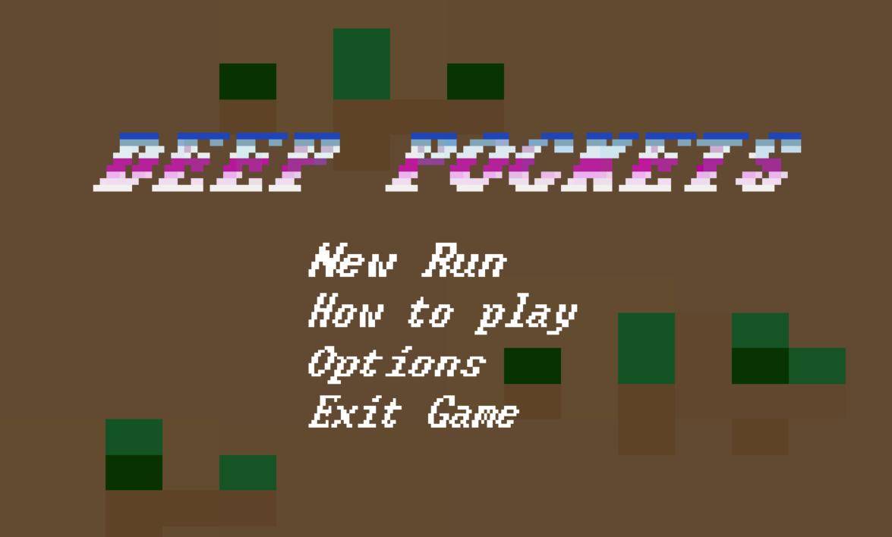
Too much fancy,
not enough fun.

Slide 4
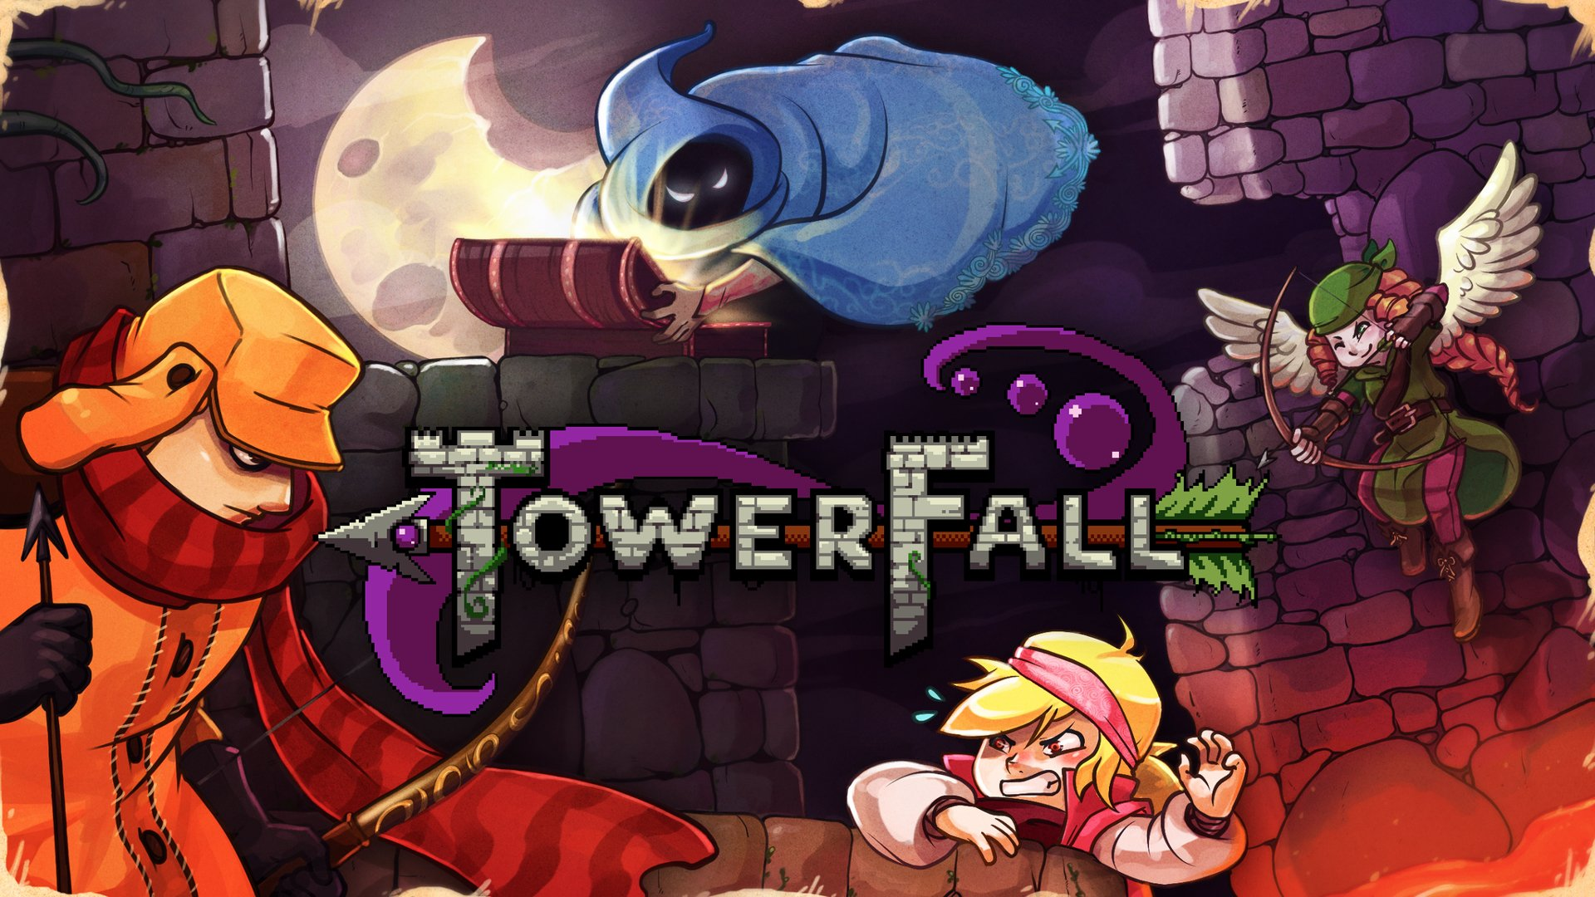
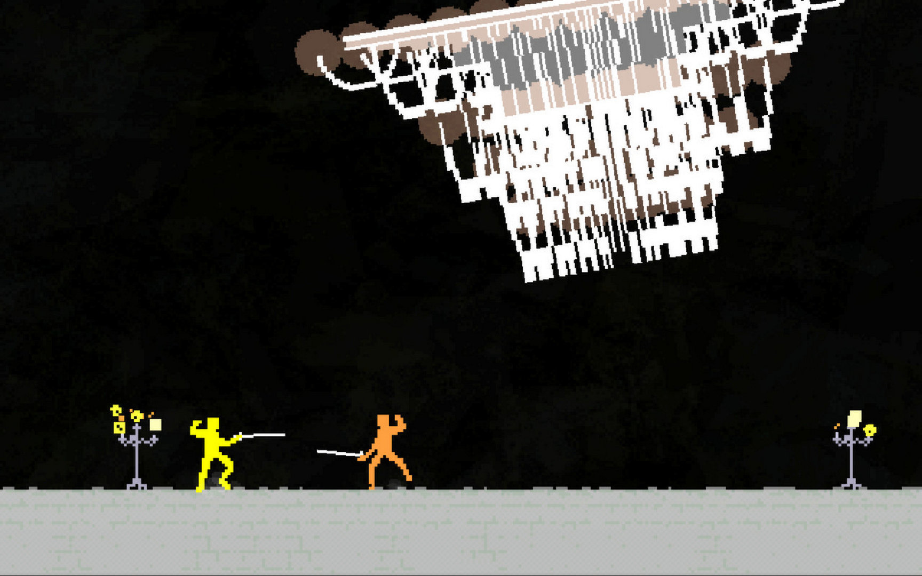
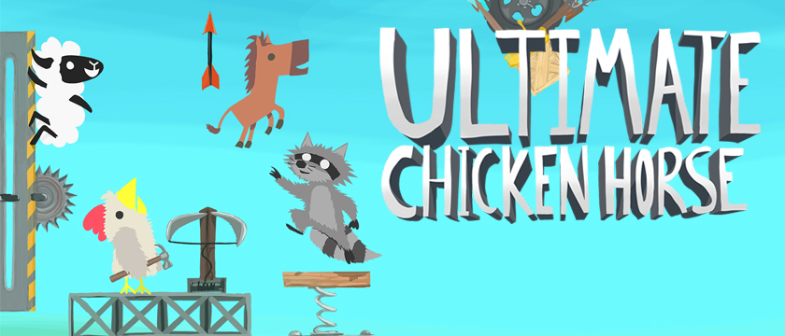
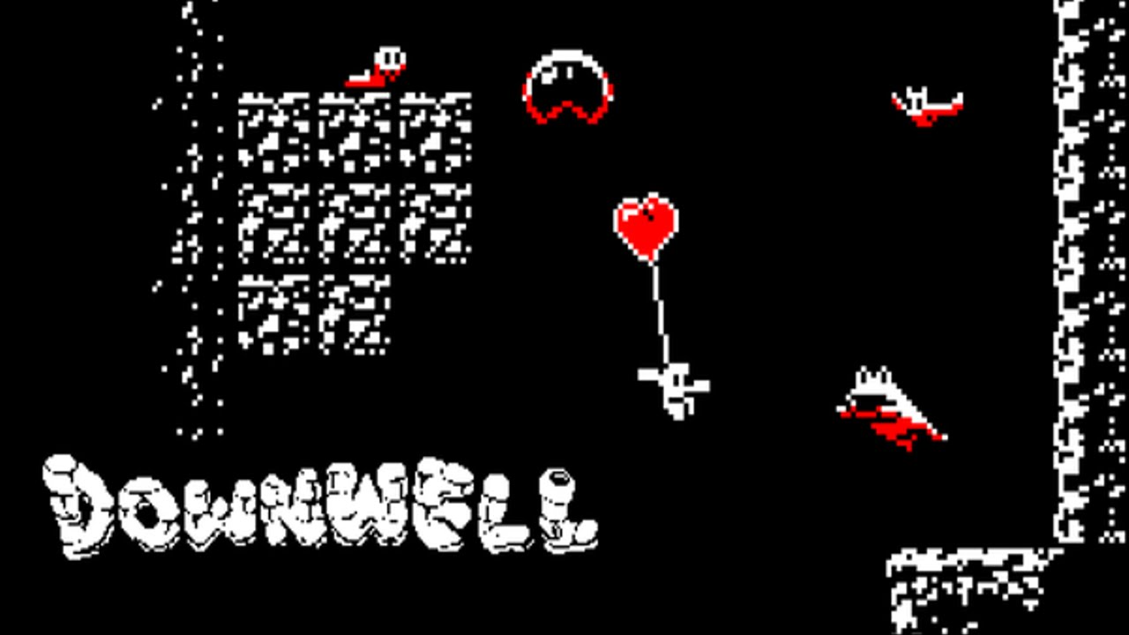
Game Idea:
Escape the Well!
a 2D Multiplayer Platformer
Taking inspiration from:
- Tower Fall (Multiplayer)
- Nidhogg (Art Style)
- Downwell (Verticality)
- Ultimate Chicken Horse (Goal)

Slide 5
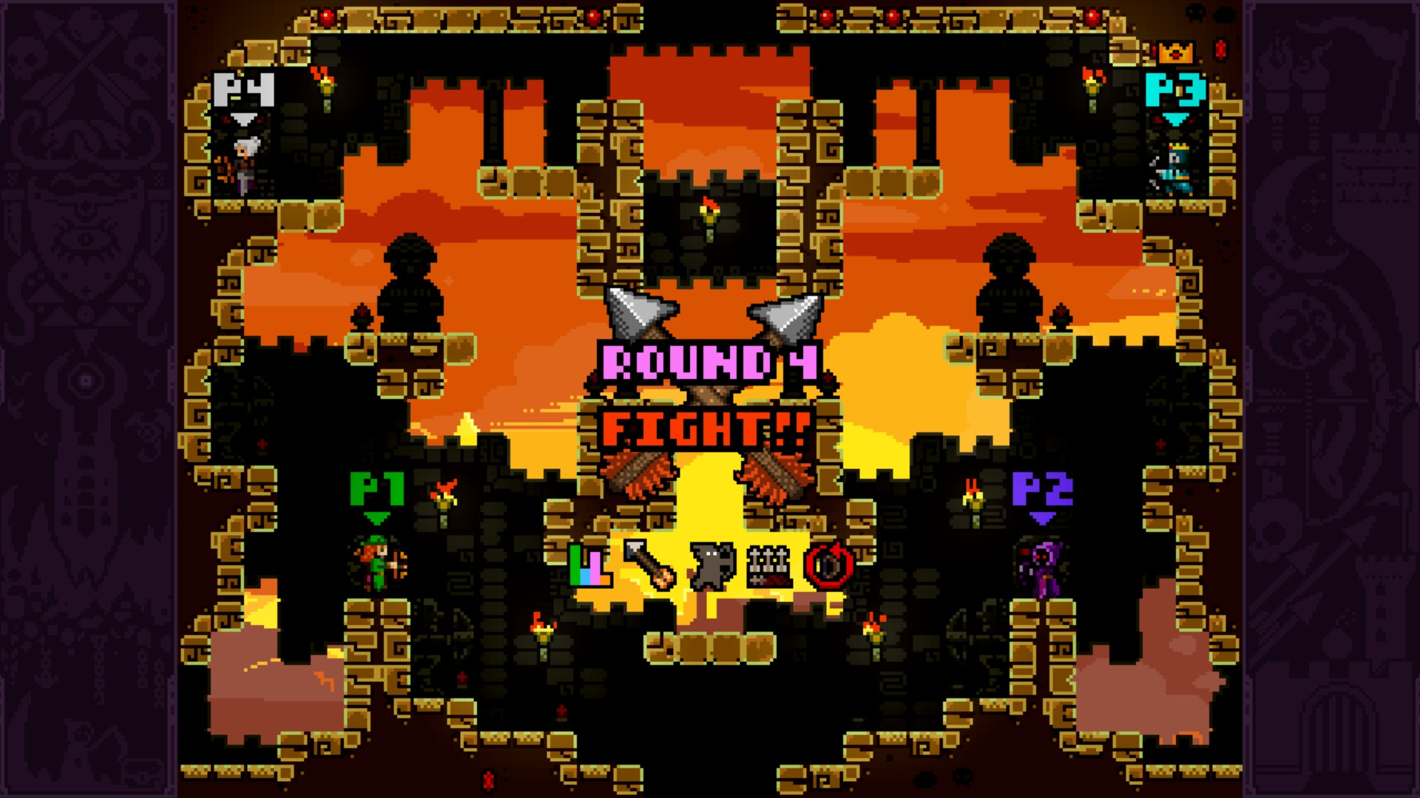
What is it?
2 – 4 players
Round-based combat with no health bars
First player to reach the exit gets the most points
Fast paced gameplay!

Slide 6

Working Prototype:
Direction: Fast, Simple, and Fun.

Slide 7
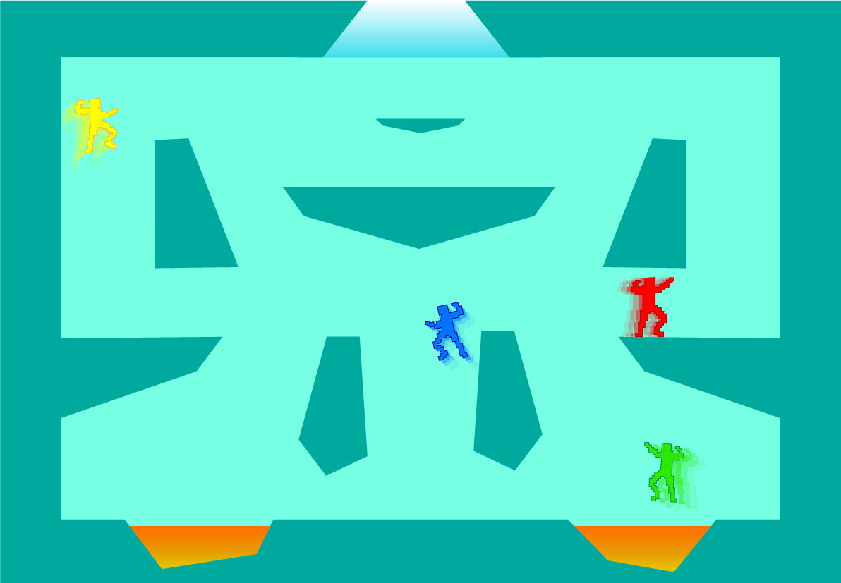
“Concept Art”

Slide 8
Questions?
Looking for team members:
Artists
Game Designers
Sound / Music Designers
Anybody

